Slide 1

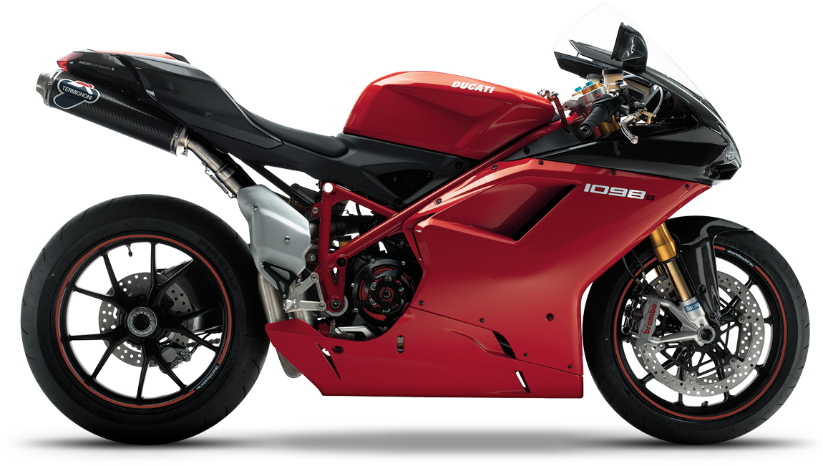
MAIN KINDS OF LOGISTICS ACTIVITY

Slide 2
THERE ARE 13 MAIN PRINCIPALS OF LOGISTICS ACTIVITY

Slide 3
Customer service
Logistics communication
Order processing
Demand forecast
Packaging
Cargo conversion
Stock management

Slide 4
Customer service
Satisfaction
Product
Place
Just in time
Costs

Slide 5
Time
Product
Customer
Place
Promotion
Price

Slide 6
Demand forecast
Stock management
Product amount
Stocks
Raw material
Strategy
Spare parts
Researches
Not-finishing production
Analysis
Their own resources
Special programmes

